Slide 1
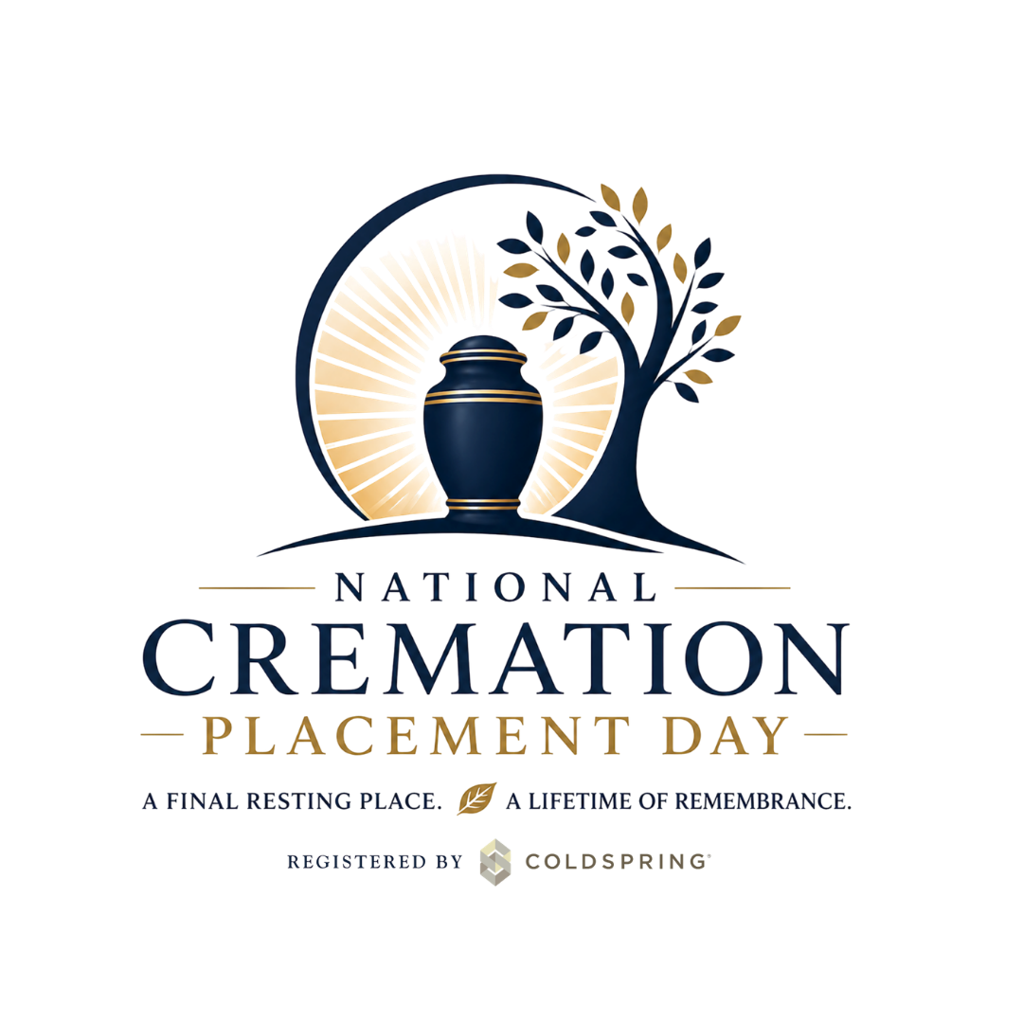


Staff training & program implementation
National Cremation Placement Day
Staff Training & Program Implementation
© 2026 Coldspring
| coldspringusa.com
Notes:
Audience: Cemetery counselors, funeral directors, family service advisors, location leadership, event/logistics support
Length: 75–90 minutes
Goal: Equip staff to deliver National Cremation Placement Day as a community memorial with robust pre‑event outreach and on‑site support that reduces families’ burden and supports healthy grief.

Slide 2

Meeting Agenda
Purpose & Context
Advance outreach, education & marketing
The required community service
Supporting placement decisions
Ethics, success measures & closing
© 2026 Coldspring
| coldspringusa.com

Slide 3
Purpose & content
National Cremation Placement Day
Staff Training & Program Implementation
© 2026 Coldspring
| coldspringusa.com
Notes:
Audience: Cemetery counselors, funeral directors, family service advisors, location leadership, event/logistics support
Length: 75–90 minutes
Goal: Equip staff to deliver National Cremation Placement Day as a community memorial with robust pre‑event outreach and on‑site support that reduces families’ burden and supports healthy grief.

Slide 4

Why We Are Here
National Cremation Placement Day is a community education initiative.
This is a community education initiative, not a sales event.
The community service is required and is the foundation of the program.
Our promise: honor, support, and clarity – never pressure.
© 2026 Coldspring
| coldspringusa.com

Slide 5

What we already know as professionals
National Cremation Placement Day is a community education initiative.
Community Memorial Services Work
Candle-lighting, ornament placement, remembrance services: high attendance, lasting impact, annual loyalty.
National Cremation Placement Day leverages the same truth: shared ritual helps people grieve.
© 2026 Coldspring
| coldspringusa.com

Slide 6
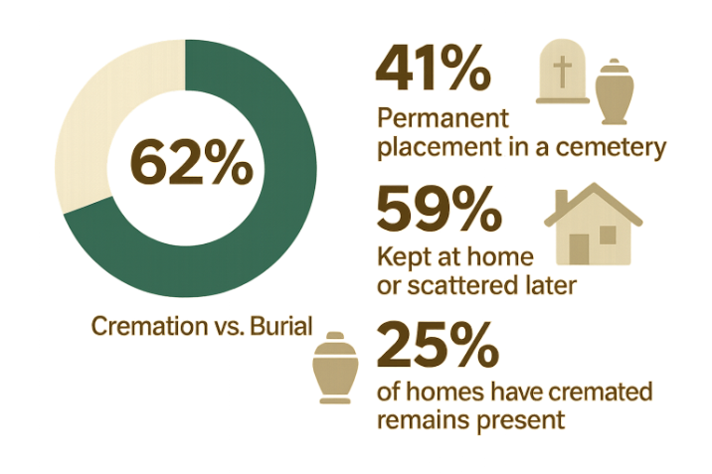
The Cremation Landscape We Serve
Cremation Has Changed the Sequence
Cremation is now the majority disposition in the United States; the trend continues to rise.
Many families finish cremation without a plan for a permanent resting place – leaving key decisions for later.
Source: 2025 NFDA Cremation and Burial Report​
Notes:
Trainer cue: Families aren’t avoiding decisions because they don’t care; they’re overwhelmed and uncertain. [nfda.org], [iccfa.com]

Slide 7
Why National Cremation Placement Day exists
Restoring the missing moment
Provides collective knowledge and public remembrance.
Re-creates a communal “laying to rest” moment often separated from death by cremation.
Offers a dignified time and place for remembrance and guide decisions permanent placement.
Notes:
Research note: Rituals are perceived as helpful when they fit families’ needs; meaning and choice matter more than “size.” [tandfonline.com], [journals.sagepub.com]

Slide 8
Advance outreach, education & Marketing
Before the Day
National Cremation Placement Day
Staff Training & Program Implementation
© 2026 Coldspring
| coldspringusa.com
Notes:
Before we discuss the service flow, we want staff to understand why preparation is essential to making the day feel like relief, not pressure.

Slide 9

Why outreach happens before the event
NATIONAL CREMATION PLACEMENT DAY BEGINS WEEKS AHEAD
Success depends on what families know and decide beforehand.
Advance outreach lets families process, talk with relatives, and explore options without pressure – so the event feels like relief.
Provides an opportunity to navigate families through the required preparation to lay their loved one at rest on National Cremation Placement Day.
Notes:
Research note: Rituals are perceived as helpful when they fit families’ needs; meaning and choice matter more than “size.” [tandfonline.com], [journals.sagepub.com]

Slide 10

What we’ve learned from our own memorial events
PREPARATION MAKES RITUALS
MEANINGFUL
Families who know the purpose arrive with intention.
The event then feels ceremonial and celebratory, not administrative.
National Cremation Placement Day is the same model – plus practical outcomes.
Notes:
Use this slide if you have done other event sin the past.
Research note: Rituals are perceived as helpful when they fit families’ needs; meaning and choice matter more than “size.” [tandfonline.com], [journals.sagepub.com]

Slide 11
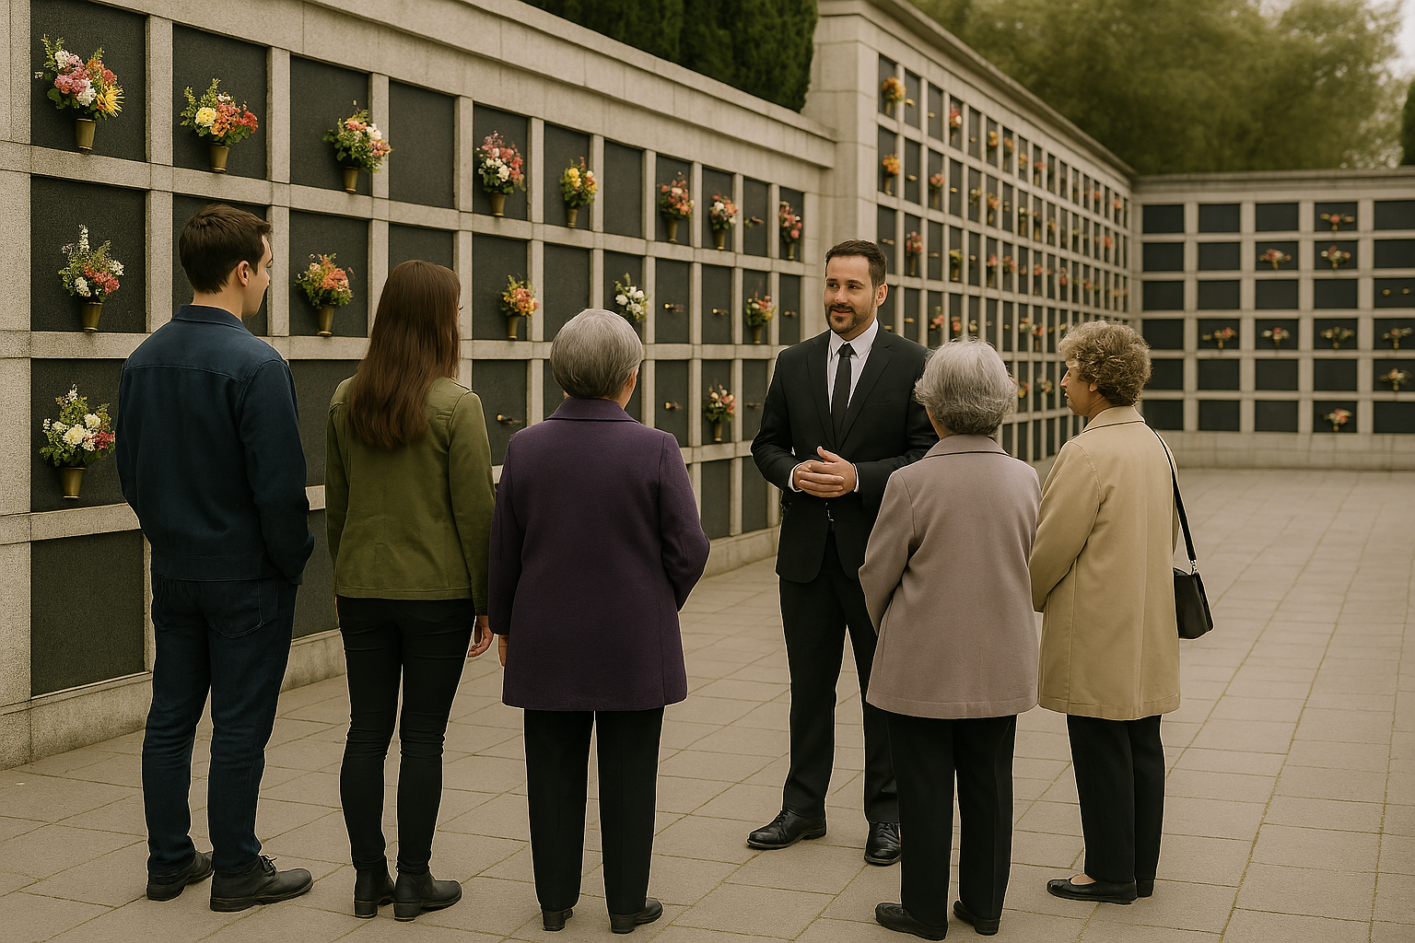
What families should learn in advance
CORE EDUCATIONAL MESSAGES
Why permanent placement is important in the grieving process and the final step in honoring their loved one.
What permanent placement means and available options on your grounds.
Attending doesn’t oblige immediate placement. They can decide now or later;
  Allows time in advance for families who are ready to make decisions on permanent placement.
  Provide an opportunity for other families to make future decisions on permanent placement.
Notes:
Industry context: National associations emphasize educating cremation families about memorialization and permanent placement. [iccfa.com], [iccfa.com]

Slide 12

Outreach & marketing language
LEAD WITH HONOR, NOT URGENCY
A day of remembrance and reflection for families with cremated remains with opportunities for permanent placement
Honor your loved one and explore next steps – at your pace
Families can only make good decisions if they are educated on their options.
Avoid: deadlines, discounts, ‘final decisions’ or pressure framing.
Notes:
Industry context: National associations emphasize educating cremation families about memorialization and permanent placement. [iccfa.com], [iccfa.com]

Slide 13
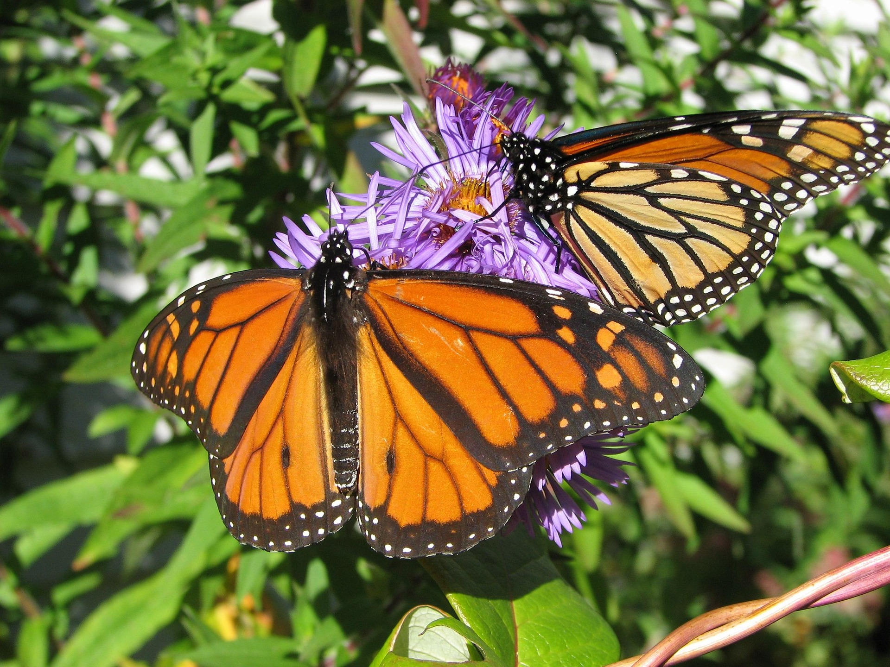
Encourage Advance planning
WHY PLANNING BEFORE THE DAY TRANSFORMS THE DAY
Families who pre-select a niche/space, review inscriptions, and complete forms experience the day as a relief.
For many, it feels like fulfilling a promise and sharing responsibility across generations.
Families often carry years of uncertainty and quiet responsibility. The community service helps lift the burden from private weight to shared witness.
Notes:
Trainer cue: “Prepared” and “pressured” are opposites; we create the former.

Slide 14

The three-part model
HOW OUTREACH, COMMUNITY EVENT, AND SUPPORT FIT TOGETHER
Outreach & Education (Before) – Inform, normalize, prepare
Community Service/Event (During) – Honor, witness, validate
Placement Support (After & Ongoing) – Assist, document, follow up
Outreach
Service
Support

Slide 15
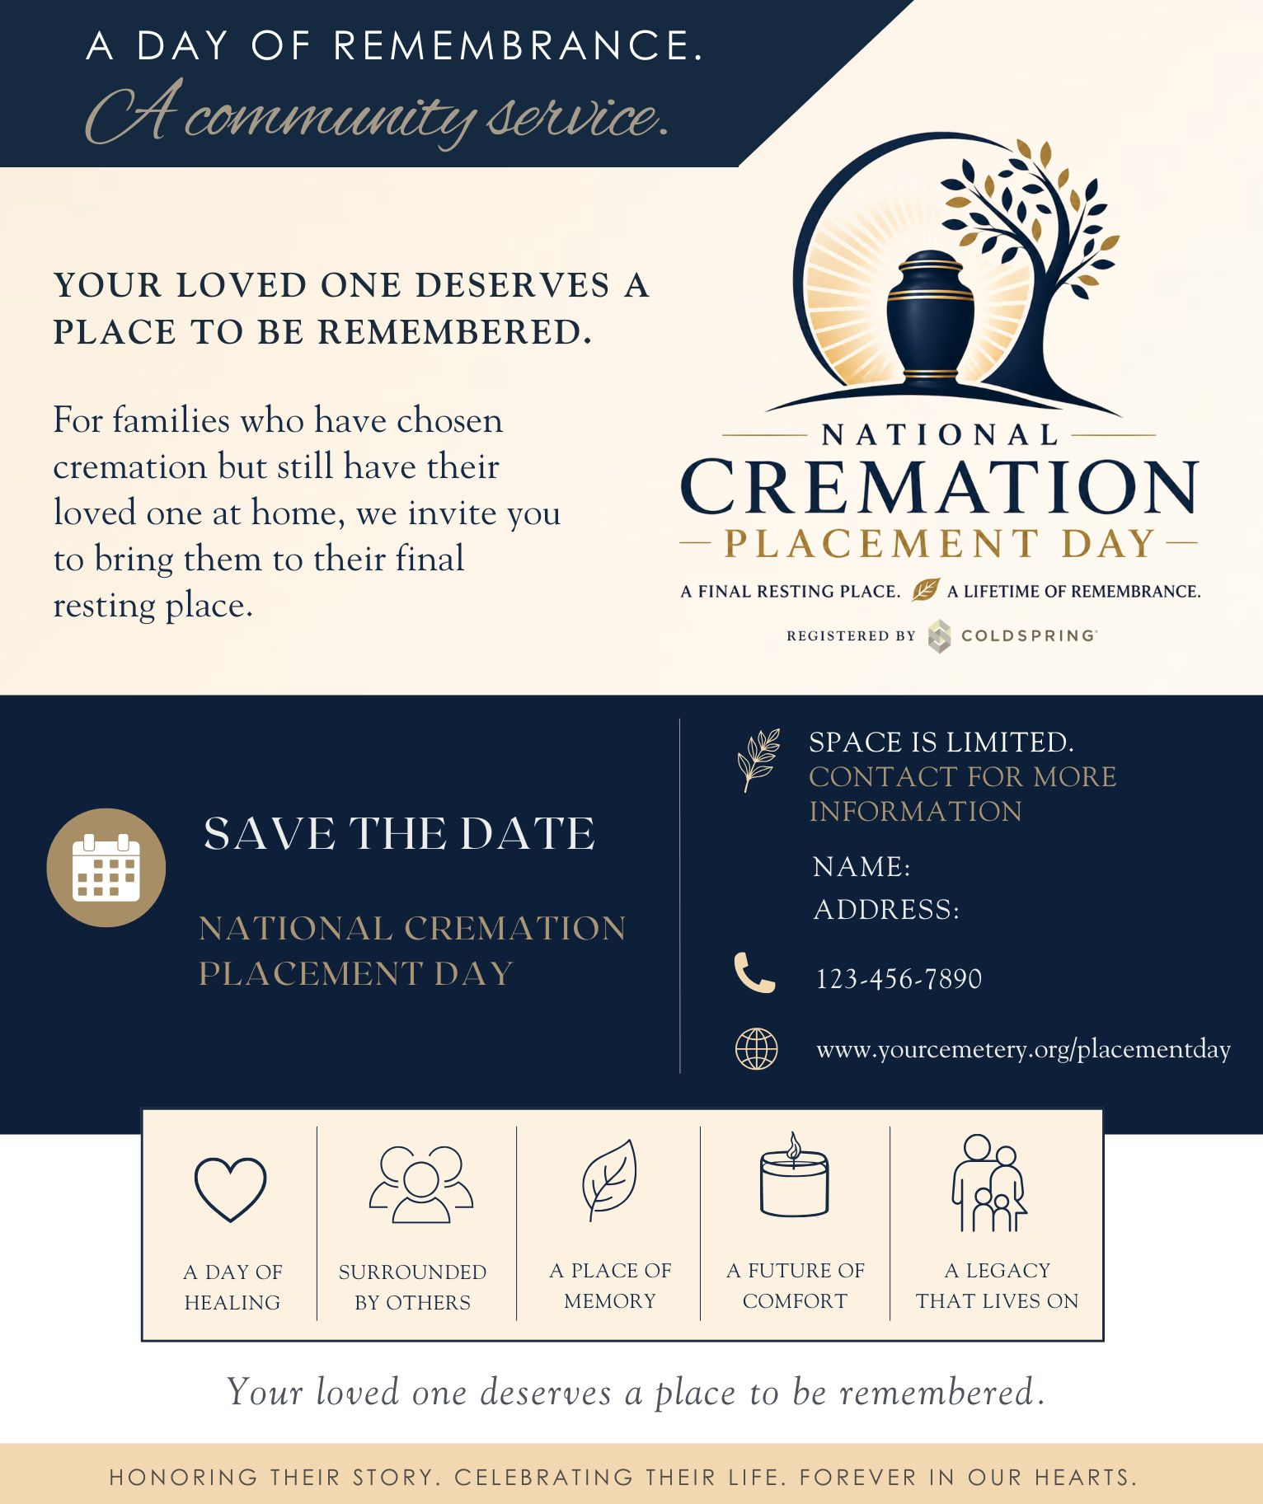
Staff Responsibilities before the event
YOUR ROLE IN PREPARATION
Answer questions; share the consumer handout; offer planning appointments.
Understand families readiness to select permanent placement now or in the future so you can help them explore options
Coordinate with funeral-home partners to invite past cremation families.
Notes:
Clinical framing: Relief ≠ “closure”; it’s healthy resolution and orientation. [bereavemen...center.org]

Slide 16

Marketing with integrity
EDUCATE, INVITE, RESPECT READINESS
Market the service and education first; present placement as available support.
Align with funeral homes’ successful memorial events messaging (Candle-lighting, ornament services).
Build trust by keeping promises in tone, content and pacing

Slide 17

What staff will notice on the day
PREPARED FAMILIES EXPERIENCE IT DIFFERENTLY
More engaged in the service , fewer anxious questions, clearer decisions, more gratitude.
Unprepared families still benefit from the service and often return later – trust is seeded in the honest engagement

Slide 18
The required community service during the Day
National Cremation Placement Day
Staff Training & Program Implementation
© 2026 Coldspring
| coldspringusa.com

Slide 19

The community service is mandatory
THE EMOTIONAL ENGINE OF THE PROGRAM
The service creates emotional safety and normalizes grief.
Places a day on the calendar to dedicate their intentions and commitment to permanent placement.
The event is pivotal in ensuring a community response to take action in creating the necessary final resting place for their loved one.
Removing the service undermines the entire initiative.

Slide 20
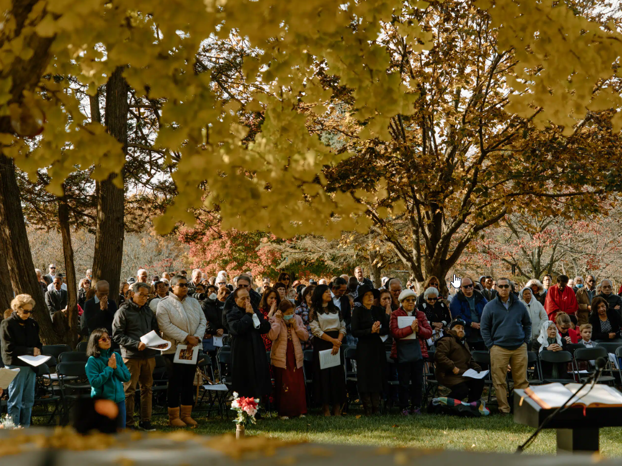
Why group ritual is powerful
CONTINUING BONDS, WITNESS, AND BELONGING
People grieve better when grief is witnessed and shared.
The service validates loss and gives families permission to act.
Provides a permanent place of remembrance for current and future generations
Notes:
Research note: Ritual fit and meaning help; continuing bonds are healthy; place anchors grief. [tandfonline.com], [bereavemen...center.org]

Slide 21


The hero framework (staff alignment)
WE BRING OUR HEROES HOME
Society honors fallen heroes with ceremony and place – sometimes decades later.
Many heroes don’t wear uniforms; they are our persona; heroes.
Honor requires a place – this is the H.E.A.R.T Method connecting to permanent placement.
Notes:
Research note: Ritual fit and meaning help; continuing bonds are healthy; place anchors grief. [tandfonline.com], [bereavemen...center.org]

Slide 22

The hero framework (staff alignment)
WE BRING OUR HEROES HOME
Society honors fallen heroes with ceremony and place – sometimes decades later.
Many heroes don’t wear uniforms; they are our persona; heroes.
Honor requires a place – this is the H.E.A.R.T Method connecting to permanent placement.
Notes:
Research note: Ritual fit and meaning help; continuing bonds are healthy; place anchors grief. [tandfonline.com], [bereavemen...center.org]

Slide 23
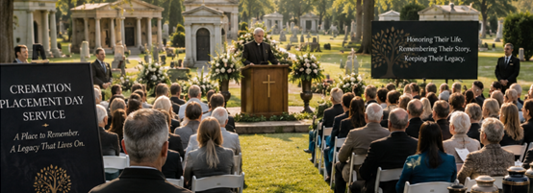
Service structure & roles
Recommended Flow (25-30 minutes)
Roles: Greeters, guides, officiant/reader,
logistics, quiet presence staff
Welcome & purpose
Collective remembrance reading
Naming/symbolic act (candles, flowers, stones)
Reflection on continuing bonds
Closing words of honor
Invitation to remain, reflect, or speak with staff

Slide 24
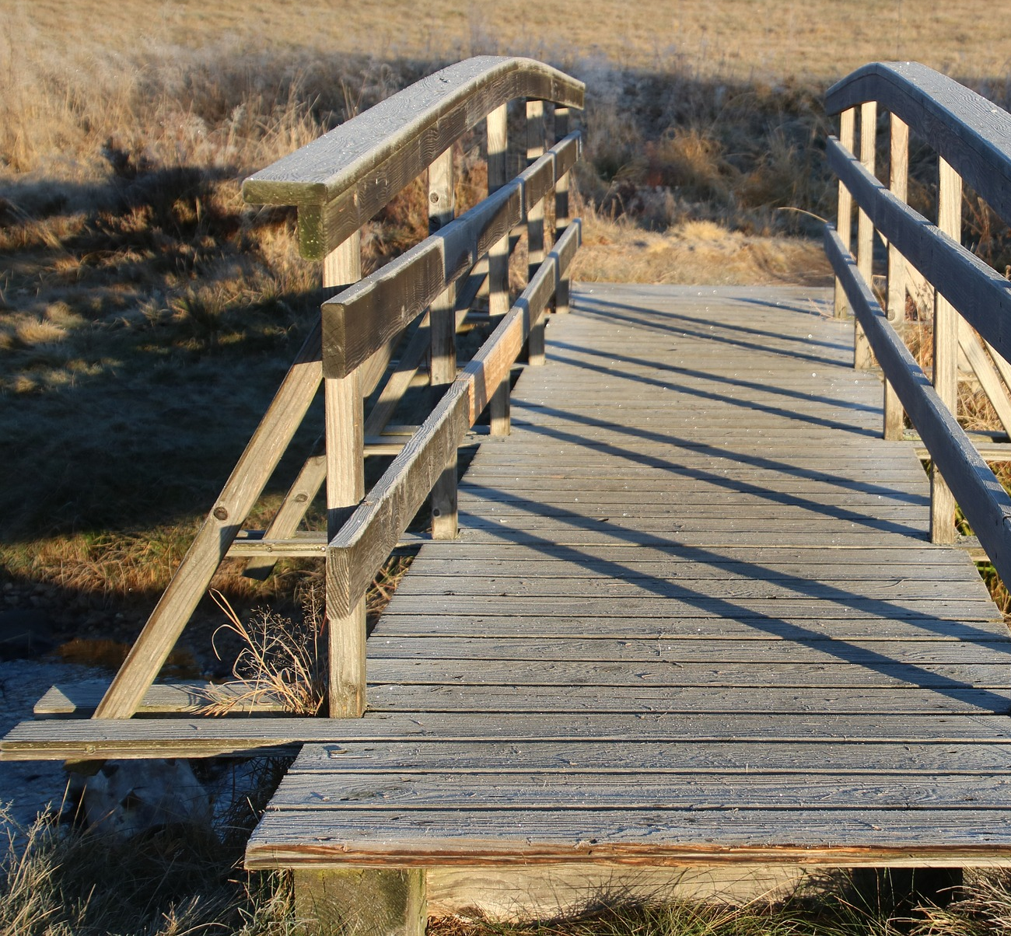
The transition after the service
FROM MEANING TO SUPPORT
Interactions following the event should use soft invitations:
  “If today brought up questions…”
  “Whether you’re ready now or not, we’re here…”
Never pivot into sales talk at the event; let families approach you.
Notes:
Trainer cue: The service opens hearts; conversations follow.

Slide 25
Supporting placement decisions
After the Service & Ongoing
National Cremation Placement Day
Staff Training & Program Implementation
© 2026 Coldspring
| coldspringusa.com

Slide 26

What placement support looks like
ASSIST THOUGHTFULLY, NEVER RUSH
Private, quiet spaces; simple options explained; transparent pricing, clear next steps
Offer both/and solutions (scattering and plaque; partial retention and niche.

Slide 27

Documentation, chain of custody & records
DIGNITY IN THE DETAILS
Verify legal authority; complete authorizations; map/record locations; provide deeds/confirmations; internment authorization form;
Gather meaningful information to briefly eulogize each loved one.
Ensure inscription approvals and proofing; schedule unveiling/visitation.

Slide 28

After the event: completing the circle
FOLLOW-UP AS CONTINUATION OF CARE
Thank you message; summary of any decisions; gentle timeframe for next steps; grief resources; invite to future remembrance events.
Measure success by support given, not just same-day placements
Notes:
Industry framing: National organizations emphasize permanent memorialization as enduring comfort and shared remembrance. [iccfa.com]

Slide 29
Ethics, success measures & closing
National Cremation Placement Day
Staff Training & Program Implementation
© 2026 Coldspring
| coldspringusa.com

Slide 30

Ethics and language
HONOR, CHOICE, AND FIT
✅SAY: “WE’RE HERE AT YOUR PACE.” “MANY FAMILIES CHOOSE BOTH SCATTERING AND A PLACE.”
❌ AVOID: “CLOSURE”, “YOU’LL REGRET IT”, OR ANY PRESSURE CUES.
Notes:
Research note: Studies show elaborateness doesn’t determine grief outcomes; fit and meaning do. [journals.sagepub.com]

Slide 31

Measuring success (beyond revenue)
INDICATORS THAT MATTER
Families felt seen, supported, and less burdened.
Increased clarity and trust; steady follow-ups; future event attendance.
Placement may occur that day or later – both are success.

Slide 32
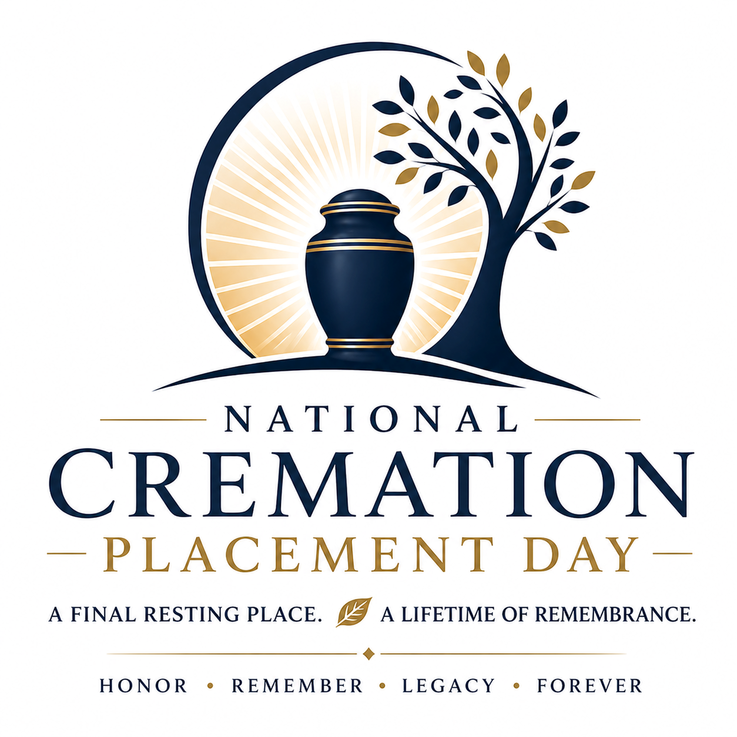
Our professional north star
WHY THIS WORK MATTERS
Our role isn’t to tell families how to grieve.
Our role is to remove unnecessary burden and provide a place for love to be honored.
At the end of the day, our community will be better educated on cremation and the importance of permanent placement and memorialization.

Slide 33
Thank you
National Cremation Placement Day
Staff Training & Program Implementation
© 2026 Coldspring
| coldspringusa.com

